Slide 1
Programming Language Assignment
Group 3
Le Quang Minh – 20176987
Nghiem Quoc Cuong – 20176971
Nguyen Chi Hieu – 20176975
Luong Minh Phuong - 20176994

Slide 2
I. Introduction

Slide 3
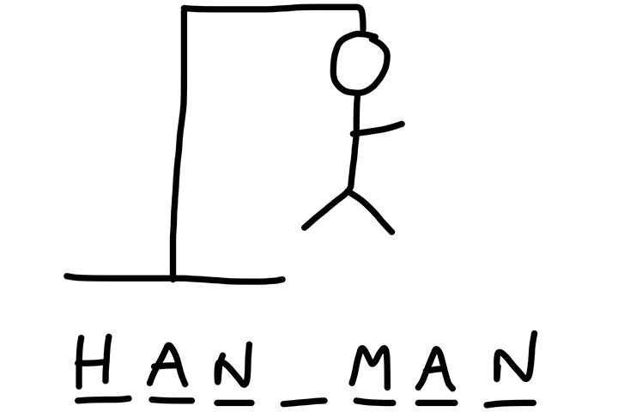
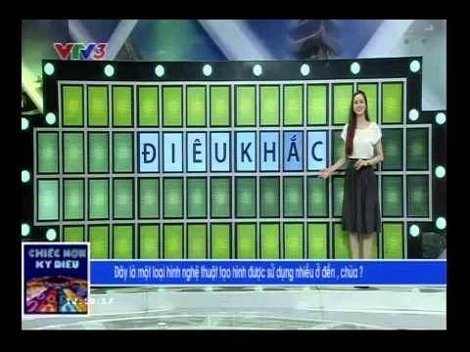
Idea
HANGMAN game
CHIEC NON KI DIEU show

Slide 4
Rules
For instance, the secret word is: CLASS
You guess the letter I. Then, there are 2 cases:
Your letter is in the secret word, then it will be shown on the screen
Your letter is not in the secret word (no letter I in the word CLASS): The computer will tell you that there is no letter I in the secret word, and your chances left is decreased by 1.
The game continues till you find all the letters in the secret word (YOU WON!) or you have no chances left (YOU LOST!)

Slide 5
Rules
In case, there are same letters in the secret word, the console will show 2 or 3 letters at once.
For example, if player guesses the letter S, the console should be:
Players do not have to type the same letter many times

Slide 6
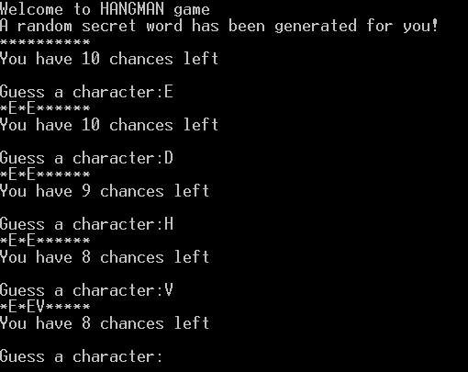
Final Result
The expected final results should be like this:

Slide 7
II. Process

Slide 8
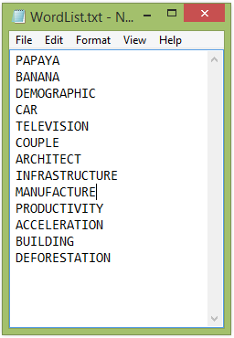
1. Choose a random word
First, we randomly choose a word from a list of secret word from an external file:

Slide 9
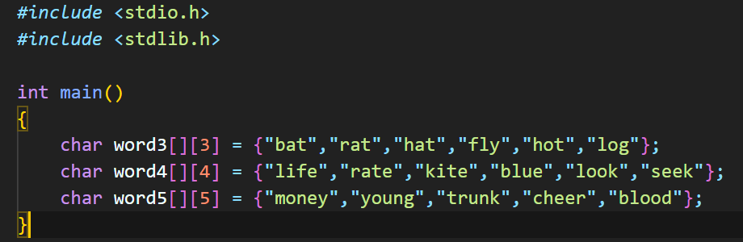
1. Choose a random word
Or we may choose a random word by creating arrays of string:
Disadvantage:
The secret word is within the code
Need to modify size of string -> Not convenient

Slide 10
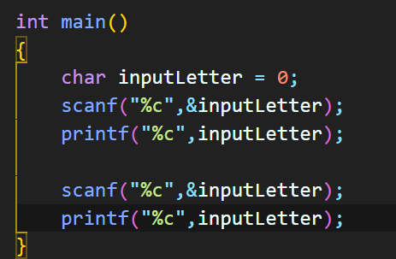

2. Input character
After a secret word is chosen. We then let player input the letter they guess using scanf() function
Results:

Slide 11
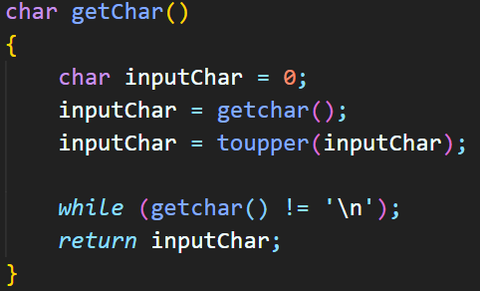
2. Input character
So we decide to use an advanced input method, using getchar() function

Slide 12
3. Check the letter
For example, the secret letter is CLASS
We create an array has the form of 00000
If the guessed letter is correct, e.g: L, the array above will be changed to 01000
The program stops when there is no 0 in the array.

Slide 13
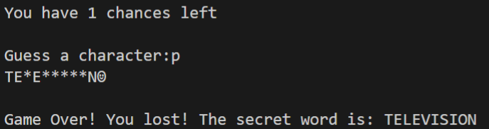
4. Make a counter
Create a counter integer, it remains the same if players guess the correct letter of the secret word
The counter is minus by 1 if players guess the wrong letter
The game is over when the counter = 0!

Slide 14
III. Difficulties

Slide 15
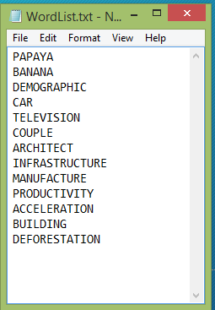
Difficulties
At the moment, we still work on how to randomly choose a secret word in the most convenient way.
Plan:
Use a .txt file to store the list of words
Import it as a string into the source code

Slide 16
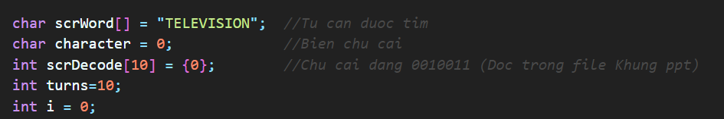
Difficulties
Need a method to automatically modify the size of the string of the secret word

Slide 17
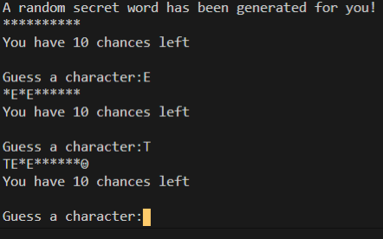
Difficulties
Sometimes, unexpected character appears!!
When letter “E” is input, the program works normally
When letter “T” is input, there is a strange symbol appear at the end

Slide 18
Knowledge Cover
Array
Use of function
New variable type: String
External library: <ctype.h>, <string.h>
Pointers

Slide 19
Developments

Slide 20

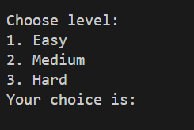
Developments
Create a Loop to ask if players want to play again
Create some levels: easy, medium, hard based on number of character of the secret word

Slide 21
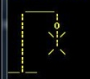
Developments
Create multiplayers option, points for correct letter
1 letter revealed = 10 points
2 letters revealed = 20 points
…
Visualize the “hang man” using printf() function!
Automatically giving hints of the secret word

Slide 22
Developments
Open randomly some of letters with some words of hard level
…
Count time to play the game
Play with many levels. After player finish the easier
words, the game continue with harder words

Slide 23
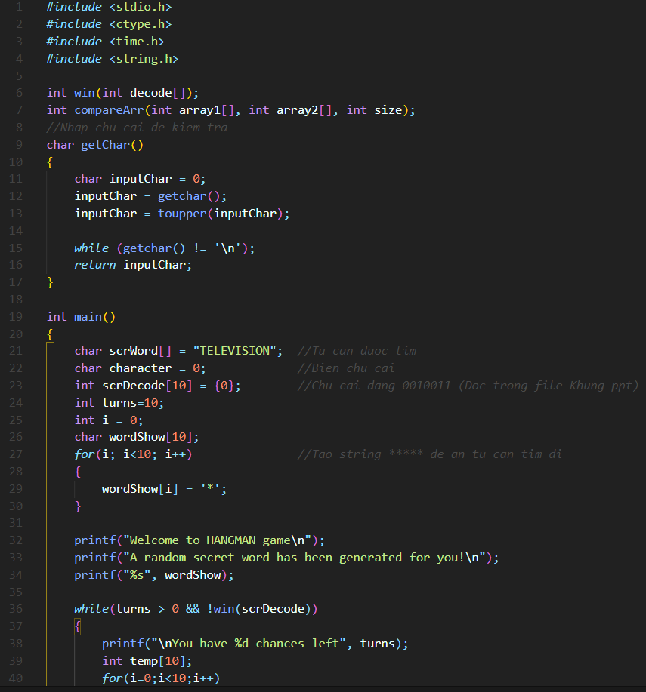
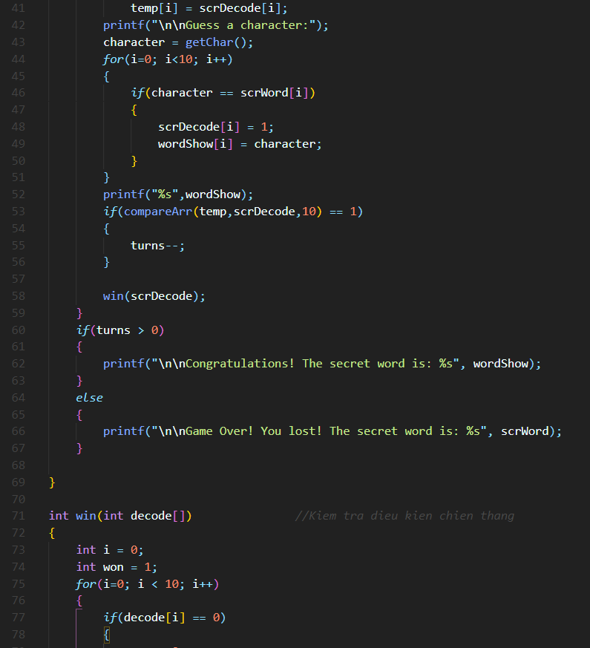
Source Code at the moment

Slide 24
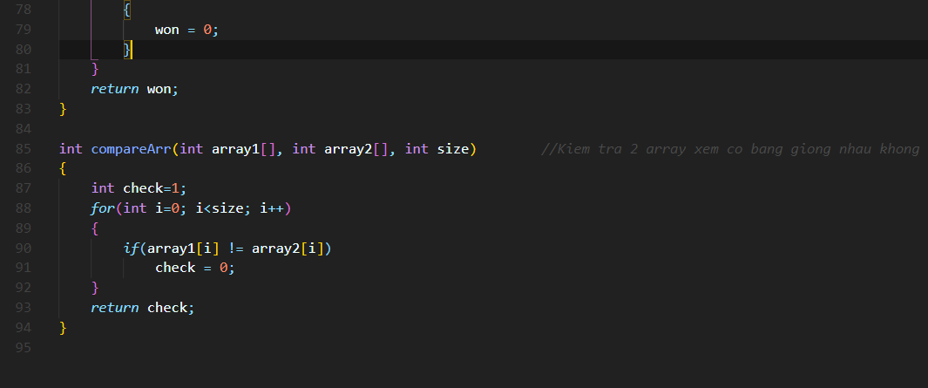
Source Code at the moment

